Slide 1

.
DEPARTMENT OF COMPUTER SCIENCE AND ENGINEERING
NOISE POLLUTION MONITORING
Team name:proj_224788_team_3
TEAM MEMBERS:
JANANI.V.V -113321104031
JAYAPREETHA.S -113321104033
JAYASRI.M -113321104034
KAMIREDDY CHARITHA -113321104035

Slide 2
OBJECTIVES
To study the existing system.
To design the block diagram.
To decide the components specification and device in system.
To design the circuit diagram and simulate it using suitable software.
To design the PCB and implement hardware.
To test the circuit and observe the result.
To prepare port.

Slide 3
INNOVATION
Innovations in noise pollution monitoring have been crucial in addressing this environmental issue. Some advancements include:
Developments in low-cost, high-precision sensors that can be deployed in various locations to continuously monitor noise levels.
Using AI algorithms to analyze large datasets from sensors, identify patterns, and predict noise pollution trends.
Apps that allow citizens to report noise disturbances, contributing to real-time data collection and community engagement.
The sensing devices are connected to embed computing system to monitor the fluctuation of parameters like noise pollution level from their normal levels.
Creating detailed noise maps of urban areas to visualize noise pollution and inform urban planning decisions.
These cameras can visually display noise sources in real time, aiding in pinpointing and addressing problem areas.
Integrating noise sensors into the Internet of Things (IoT) ecosystem for seamless data sharing and control.

Slide 4
PROJECT OBJECTIVES
Gather accurate and real-time data on noise levels in specific areas or communities.
Pinpoint sources of noise pollution, such as traffic, industrial activities, or recreational events.
Assess the impact of noise pollution on human health, wildlife, and the environment.
Ensure that noise levels conform to local regulations and standards.
Analyze noise data over time to identify patterns, trends, and potential hotspots.
Raise awareness about noise pollution and its effects on health and well-being.
Provide data to support evidence-based policy changes and urban planning decisions.
Involve the community in monitoring efforts, making them active stakeholders.
Develop and implement noise reduction strategies based on data and analysis.

Slide 5
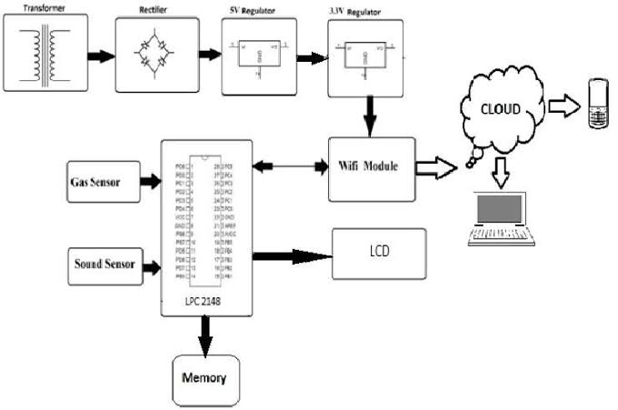
VIRTUALIZATION DIAGRAM ON IOT

Slide 6
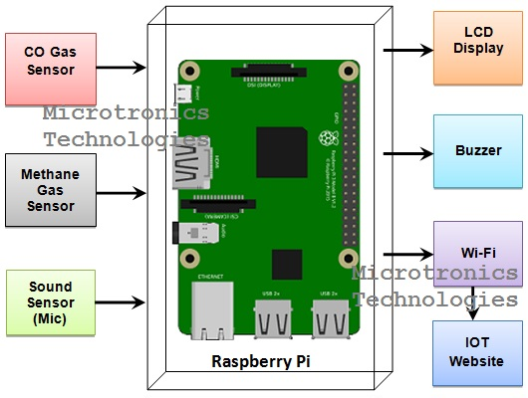
RASPBERRY PI INTEGRATION
an IOT-based method using RasberryPi is used to monitor and check live the sound pollution of a region, have been proposed.
The recommended technology comprises of two modules namely, the Sound Intensity Detection Module.

Slide 7
CODE IMPLEMENTATION
Set up your hardware:
Raspberry Pi (or any other IoT device with audio capabilities)
USB Microphone
Internet connection
Install Required Libraries:
Install necessary Python libraries using pip if they are not already installed.
Collect Audio Data:
Use Python to record audio data from the microphone.
Analyze Audio Data:
You can analyze the audio data to calculate noise levels or other relevant metrics. You may want to use Fast Fourier Transform (FFT) to analyze frequency components.

Slide 8
CONCLUSION
Noise pollution or noise disturbance is the disturbing or excessive noise that may harm the activity or balance of human or animal life.
The sources of most outdoor noise worldwide is mainly caused by machines and transportation systems, motor vehicles, aircraft and trains.
Noise pollution is very dangerous to both man and animals because it can cause many effect to their health and also to the environment.
So noise pollution should be control and be under consideration.

Slide 9
THANK YOU

